Slide 1
People Management, People Organization
Main issues:
People are key in software development
Different ways to organize SD projects
©2008 John Wiley & Sons Ltd.
www.wileyeurope.com/college/van vliet
Notes:
© SE, People, Hans van Vliet

Slide 2

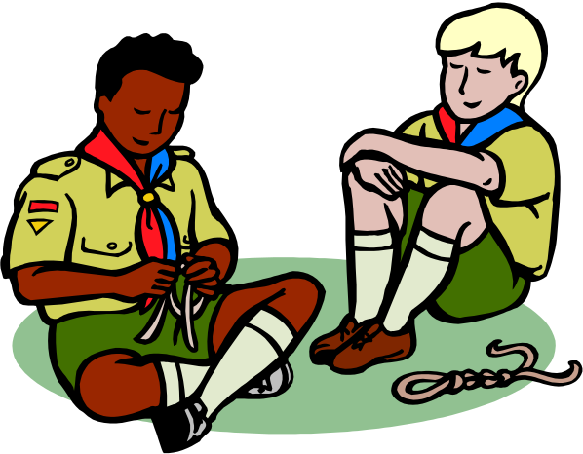
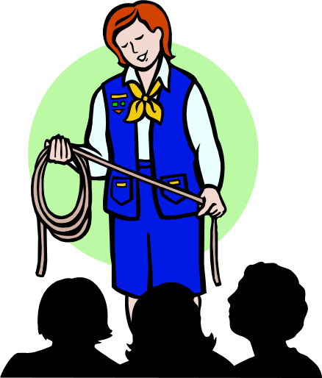
Different ways to organize people
©2008 John Wiley & Sons Ltd.
www.wileyeurope.com/college/van vliet

Slide 3
People management
People have different goals
People and productivity
Group processes
Coordination of work
Importance of informal communication
©2008 John Wiley & Sons Ltd.
www.wileyeurope.com/college/van vliet

Slide 4
Mintzberg’s coordination mechanisms
Simple: direct supervision
Machine bureaucracy: standardization of work processes
Divisionalized form: standardization of work products
Professional bureaucracy: standardization of worker skills
Adhocracy: mutual adjustment
©2008 John Wiley & Sons Ltd.
www.wileyeurope.com/college/van vliet
Notes:
© SE, People, Hans van Vliet
Simple: few bosses, many workers. The bosses use direct supervision. Often in small organizations.
Machine bureaucracy: work is completely specified. Assembly lines. Little training, much specialization.
Divisionalized form: each division has freedom to reach goals. Control is by regularly measuring the performance of the division.
Professional bureaucracy: skilled professionals are given autonomy, as in hospitals.
Adhocracy: a group of colleagues has to carry out a complex job.
These are obviously extremes.

Slide 5
External and Internal forces
Example context: a complex software development project in a new, not yet explored area, within a government agency
External force: the bureaucratic context is likely to want to push a bureaucratic type of organization, with bosses, and hierarchical decision procedures
Internal force: the project really requires a more democratic, consensus-based type of organization
©2008 John Wiley & Sons Ltd.
www.wileyeurope.com/college/van vliet
Notes:
© SE, People, Hans van Vliet
And these forces then easily clash.
See also the London Ambulance Service debacle.

Slide 6
Reddin’s management styles
task directedness
low
high
separation
style
commitment
style
low
relation
directedness
relation
style
integration
style
high
©2008 John Wiley & Sons Ltd.
www.wileyeurope.com/college/van vliet
Notes:
© SE, People, Hans van Vliet
Separation style: suited for routine work; efficiency is central theme. Management is bureaucratic. Looks like Mintzberg’s coordination through standardization of work processes style
Relation style: effective where people have to be motivated. Tasks are bound to individuals. Work is innovative. Looks like mutual adjustment scheme
Commitment style: effective when work is done under pressure. Decisions making is not done in meetings; decisions are implied by shared vision of the team. Fits professional bureaucracy.
Integration style: fits when result is uncertain. Work is explorative. Manager has to stimulate and motivate. Looks like mutual adjustment too.

Slide 7
Focus
In both these schemes, we look from the manager to the team.
We may also take the opposite position, and consider the relation and task maturity of individual team members.
The manager should align his dealings with team members with their maturity.
©2008 John Wiley & Sons Ltd.
www.wileyeurope.com/college/van vliet
Notes:
© SE, People, Hans van Vliet
For example, a fresh graduate may have high task maturity and low relation maturity. His introduction into a skilled team may then warrant some guidance.

Slide 8
Team Organization
Hierarchical organization
Matrix organization
Chief programmer team
SWAT team
Agile team/Extreme Programming (XP)
Open Source Develoment
©2008 John Wiley & Sons Ltd.
www.wileyeurope.com/college/van vliet
Notes:
© SE, People, Hans van Vliet
The first two (hierarchical and matrix) are traditional team organizations, and not specific to software development.
The latter three are quite specific to s.d.
Chief programmer team was fashionable for a while; originated within IBM. The chief programmer is the first amongst his pals.
SWAT = Skilled Team with Advanced Tools. Goes with RAD -- Rapid Application Development. The team quickly builds a series of prototypes.
Open Structured Team is from Constantine. Looks like chief programmer team, with a few more rules.
XP: Extreme Programming, the latest fad.

Slide 9

Hierarchical team
©2008 John Wiley & Sons Ltd.
www.wileyeurope.com/college/van vliet

Slide 10

Matrix organization
©2008 John Wiley & Sons Ltd.
www.wileyeurope.com/college/van vliet

Slide 11
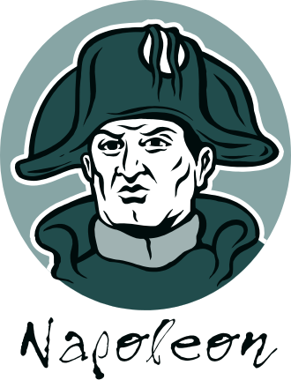
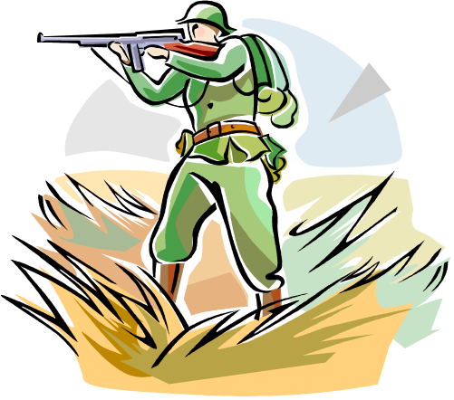
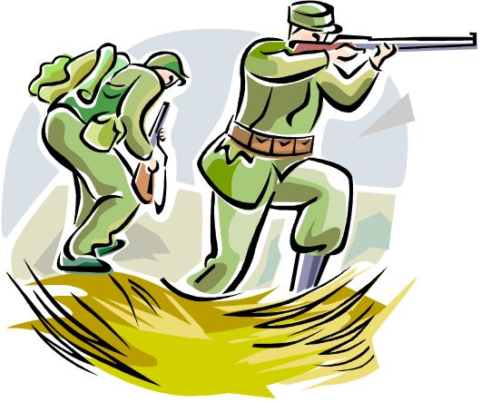
Chief programmer team
©2008 John Wiley & Sons Ltd.
www.wileyeurope.com/college/van vliet

Slide 12



Skilled worker with advanced tools (SWAT)
©2008 John Wiley & Sons Ltd.
www.wileyeurope.com/college/van vliet

Slide 13
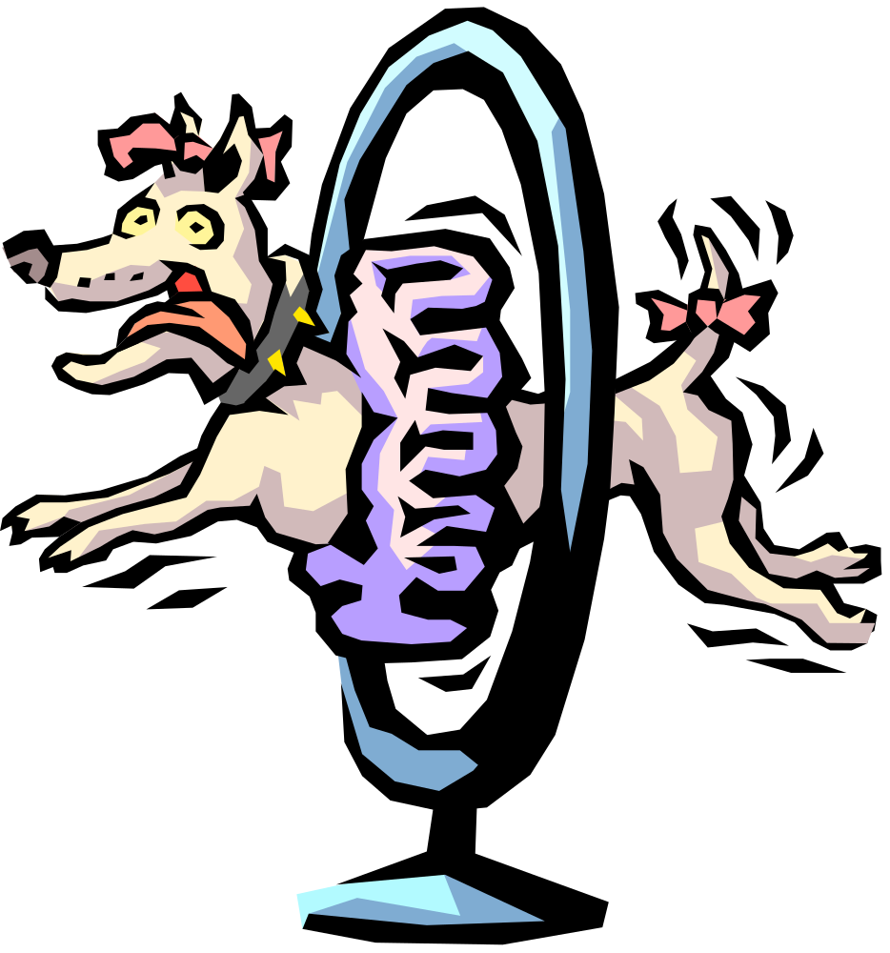
Agile team
©2008 John Wiley & Sons Ltd.
www.wileyeurope.com/college/van vliet

Slide 14

Open Source Software Development
core team
active users
passive users
co-developers
©2008 John Wiley & Sons Ltd.
www.wileyeurope.com/college/van vliet

Slide 15
Some general rules
Use fewer, and better, people
Fit tasks to people
Help people to get the most out of themselves
Look for a well-balanced team
If someone doesn’t fit the team: remove him
©2008 John Wiley & Sons Ltd.
www.wileyeurope.com/college/van vliet
Notes:
© SE, People, Hans van Vliet
- the best people are a bargain
- fit tasks to people: in particular, make sure that technical people have career paths as well
- help people: avoid the reverse Peter Principle: people rise within an organization until they become indispensible, e.g. a programmer who is the only one who knows everything about a particular system. And the Paul Principle: people rise to a level at which their expertise becomes obsolete.

Slide 16
Summary
Software is written by humans
Coordination issues/management styles
Common team organizations in software development:
  Hierarchical team
  Matrix organization
  Agile team
  Open source development
©2008 John Wiley & Sons Ltd.
www.wileyeurope.com/college/van vliet

